Slide 1
Botic
privacy aware chatbot
PRESENTATION BY ALABAMA LIQUID SNAKE

Slide 2
1
MEET THE TEAM

Slide 3

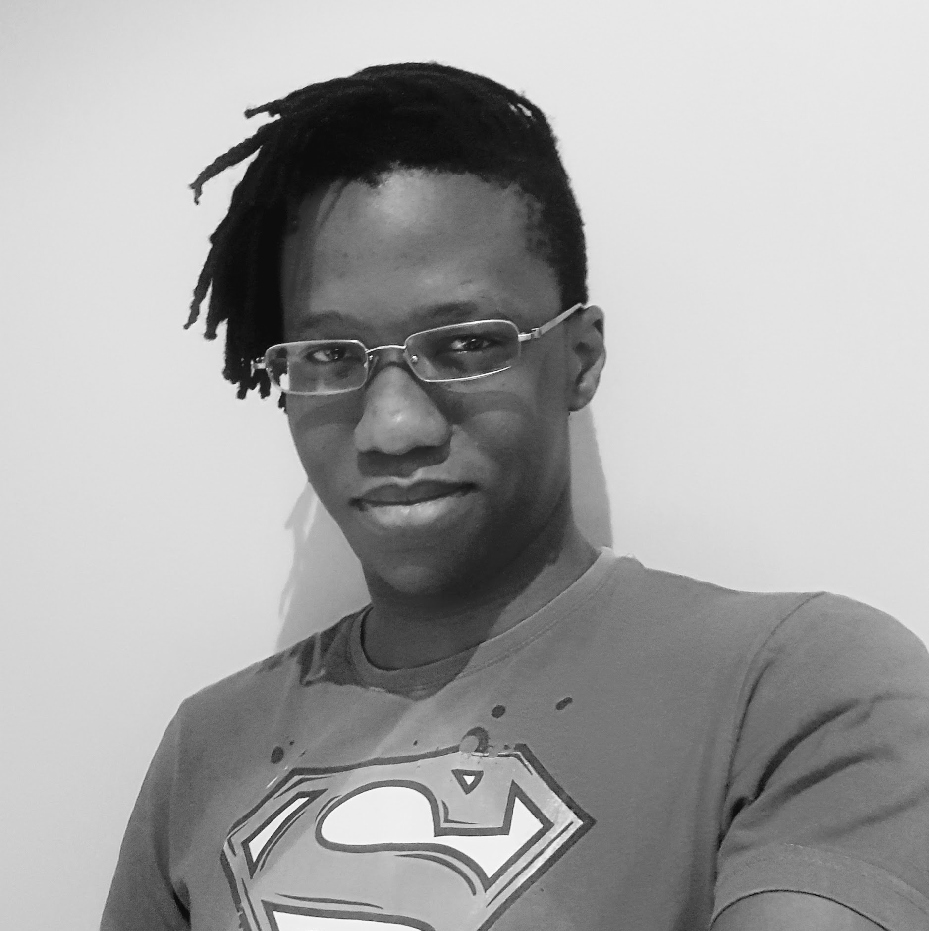
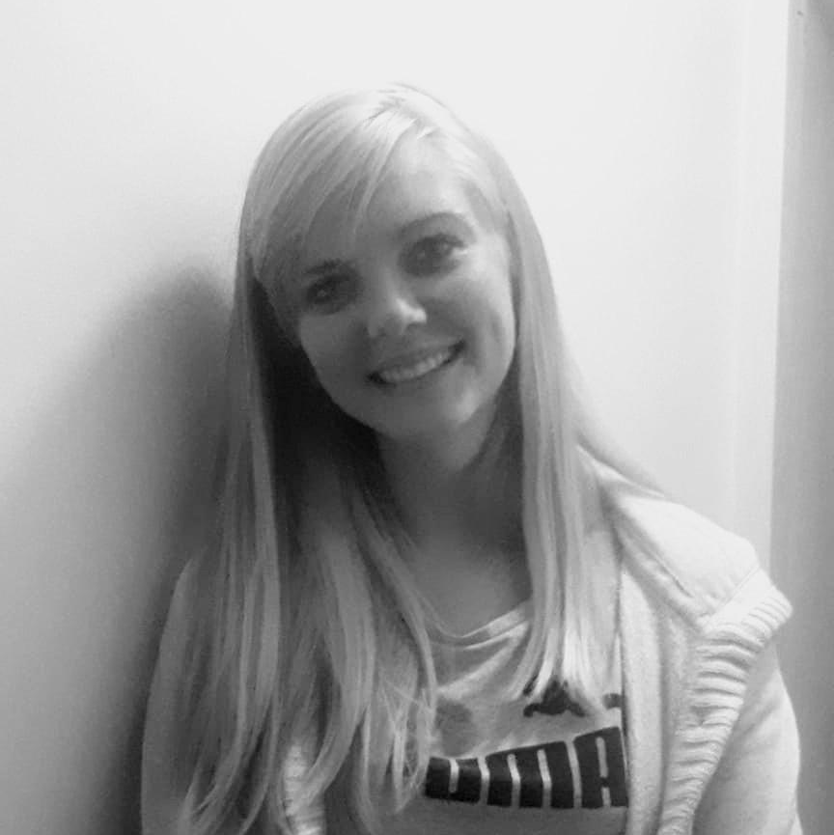
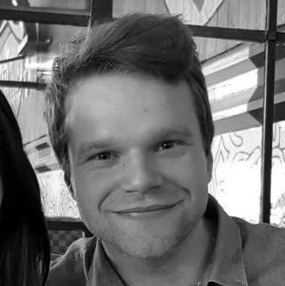
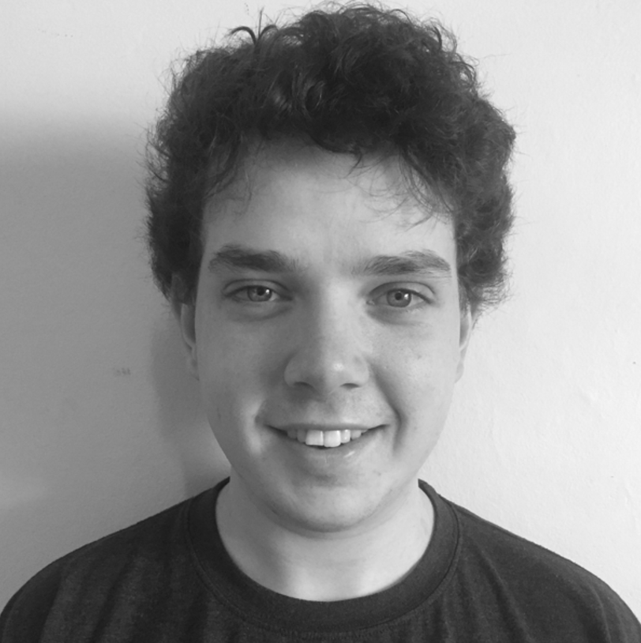
Hello!
We Are Alabama Liquid Snake
Lesego Mabe
Peter Msimanga
Alicia Mulder
Kyle Gaunt
Justin Grenfell

Slide 4
BOTIC
The privacy aware chatbot

Slide 5
1
PROJECT REQUIREMENTS

Slide 6
Simply
The system must be able to parse a user message, identify any personally identifying information that the use has entered and alert them to that fact.
Read in a text message
Use some scheme to identify personal information
Alert the user to this fact in some way
Learn from older interactions to improve itself
Be able to answer queries that the client specifies
Scrape private information from any entered communications

Slide 7
Since the Last Demo
Implemented an AI strategy that we can iterate on
Added scaffolding for customer representative interface
Added user authentication using auth0 and google accounts
Improved integration and continuous testing and added more tests
Defined how the client wants the software to interact with personal information

Slide 8
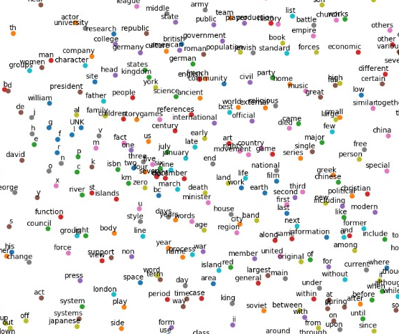
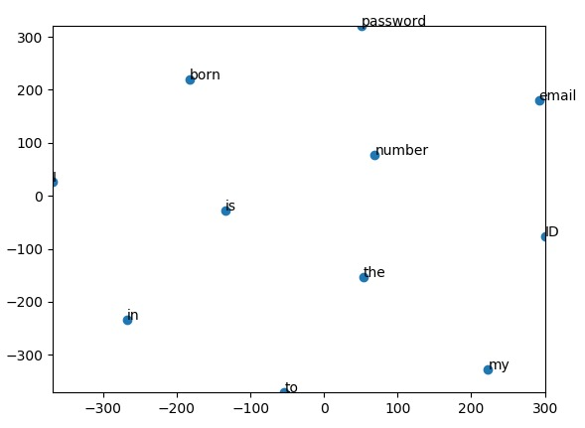
Continuous bag of words

Slide 9
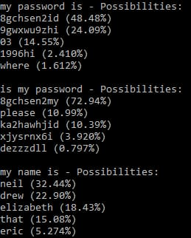

Slide 10
DEMO

